Slide 1

Climate Control System
By Chris Thomas

Slide 2
Concept
The goal of this project was to simulate a climate control system.
This requires measuring the temperature and displaying it.
And then turning on motors that represent fans for heating and cooling depending on what is needed.

Slide 3
Combining Lab 7 and Lab 5 Code
The code from lab 7 was able to cover the need for measuring and displaying the temperature.
The code from lab 5 could be used to control my motors.
It was just a matter of making some small changes to get the proper functionality.

Slide 4
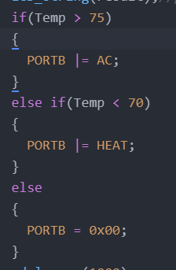
Changes to the Lab Code
Added a line of code to convert from Celsius to Fahrenheit.
Added code to control which motor would be on if any.

